Slide 1
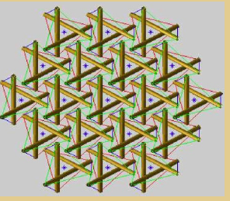
Università degli Studi di Salerno
Facoltà di Ingegneria
Workshop "Analysis and Design of Innovative Network Structures”
Solitary waves on chains of tensegrity prisms
Fernando Fraternali & Lucia Senatore 18 Maggio 2011

Slide 2
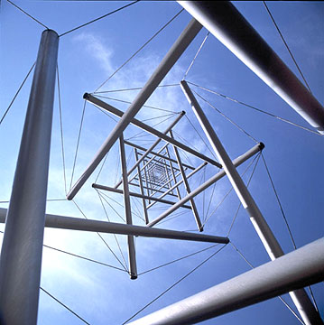
OVERVIEW
Introduction
Constitutive behavior a 3-bar tensegrity prism
Basic notions on solitary waves
Wave analysis
Strength Analysis
Concluding remarks

Slide 3
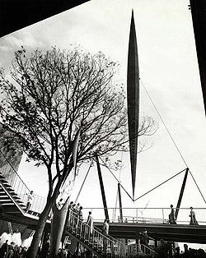
Part 1: INTRODUCTION
TENSEGRITY is a spatial reticulate system in a state of self-stress.
The structure is based on the combination of a few patterns:
Loading members only in pure compression or pure tension,
meaning the structure will only fail if the cables yield or the rods buckle.
Preload or tensional prestress, which allows cables to be rigid in tension.
Mechanical stability, which allows the members to remain in tension/compression as stress on the structure increases

Slide 4
A tensegrity configuration can be established when a set of tensile members are connected between rigid bodies.
Classes of tensegrity systems
Class I
A single rigid element in each node
One tensile element connecting the two rigid bodies
Class II
Rigid body
Two rigid elements in each node
Two tensile elements connecting the two rigid bodies
Rigid body

Slide 5
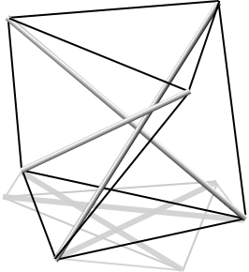
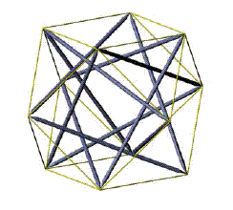
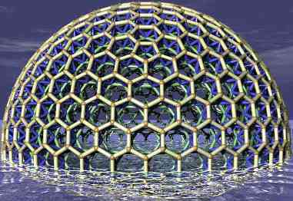
Rigid body
Class III
Rigid body
Three rigid elements in each node
Three tensile elements connecting the three rigid bodies
Rigid body
Class I
Class II
Class III

Slide 6
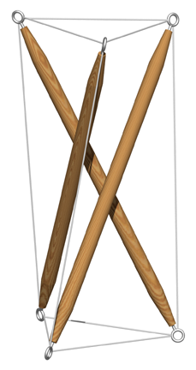
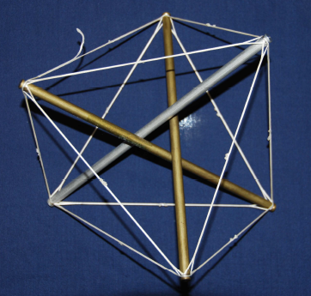
Regular minimal tensegrity prism
Regular non-minimal tensegrity prism
Tensegrity structure with minimum
number of strings equal to 9
Tensegrity structure with
number of strings major than the minimum

Slide 7
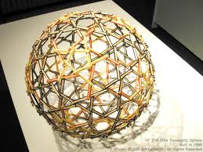
Research goals
It has been shown that 1-D systems featuring non linear force-displacement response, like, e.g, systems with power law, tensionless response (Nesterenko, 2001, Daraio et al., 2006), support energy transport through solitary waves.
We prove with this study that a similar behavior is exhibited by 1-D chains of class-1 tensegrity prisms in unilateral contact each other, through a numerical approach.
We study the dynamic response of such systems to impulsive loads induced by the impact with external strikers , through numerical integration of the equations of motions of the individual prisms

Slide 8
An initial analytic study leads us to model each prism as a non linear 1-D spring , which exhibits a “locking” type response under sufficiently large compressive forces.
The analysis of the steady state wave propagation regime allows us to detect the localized nature of the traveling waves, and the correlations occurring between the wave speed, the maximum transmitted force, the maximum axial strain, and the wave width.
By examining different material systems, we find that the locking regime supports solitary waves with atomic-scale localization of the transported energy.
We conclude the present study with a discussion of the given results, and the analysis of the possible future extensions of the current research.

Slide 9
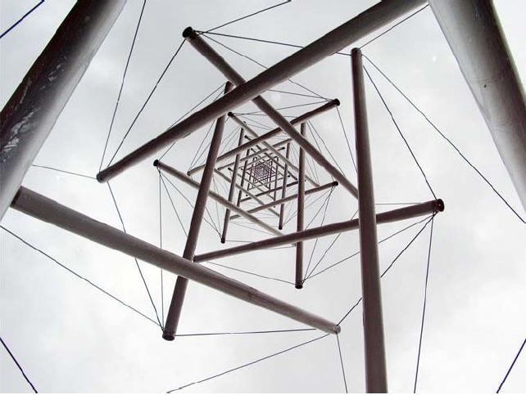
Part 2 : Constitutive behavior of a 3-bar tensegrity prism

Slide 10
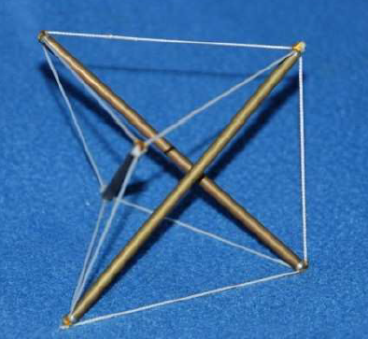
2.1 Schematic of a 3-bar tensegrity prism
 | Characteristic transverse dimension
 | Cross-cable length
 | Bar length
 | Twist angle between upper and lower bases
 | Prism height
 | Axial strain
 | Natural length of cross-cables
 | Cable prestrain
 | Cable stiffness
 | Total prism mass Elastic stiffness of the prism at equilibrium (zero axialforce)
 | Fundamental vibration period of the prism

Slide 11
Motion animation

Slide 12
2.2 Kinematics
B
Lower basis
Legs: A-
B-
C-
Cross-cables : A-
B-
C-
150 º
A
Upper basis
C

Slide 13
B
Lower base
Legs: A- Cross-cables : A-
B- B-
C- C-
150 º
A
Position vectors (upper base)
C
Upper base
Fixed length constraint on the legs
(1)
Cross- cable length
(2)

Slide 14
2.3 Force-displacement relationship
F_{a}
2.3.1 Direct approach
N_{ac}
-
-
-
-
c
F_{c}
a
Equilibrium equations
N_{aA}
-
N_{aB}
-
-
N_{cb}
-
N_{ab}
-
-
N_{cC}
F_{b}
-
-
N_{cA}
b
-
N_{bB}
-
B
-
N_{Cb}
A
C

Slide 15
Assuming vertical loading
F_{a}= {0 , 0 , -F_{a}} , F_{b}= {0 , 0 , -F_{b}} , F_{c}= {0 , 0 , -F_{c}}
and elastic behavior of the cross-cables
we can solve (9 scalar equations) for
In particular, by setting we obtain the overall force vs height relationship as :

Slide 16
2.3.2 Energetic approach
Elastic energy
By using (1) and (2) we can express U as a function of  or h
Torque
Axial force (assuming as positive compressive forces)

Slide 17
2.4 Equilibrium values of the twist angle, prism height and cable length
solution of
(3)
solution of
(4)
By solving (3), we get

Slide 18
2.5 Force vs height relationship
Upon writing
where p is the cable prestrain, we get for U(h) and F(h) the following expressions :

Slide 19
2.6 Force vs axial strain relationship
Where :
Axial strain referred to the equilibrium height (positive if compressive)
(5)
Upon substituting (5) into (4) we obtain the F vs relationship.

Slide 20
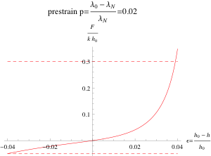
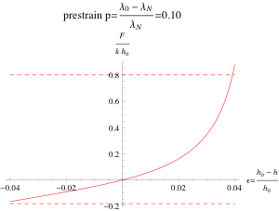
2.7 Typical F vs plots in tensegrity prisms
Low cable prestrain
High cable prestrain
lockingeffect

Slide 21
Force vs time histories in the prism elements under vertical loading

Slide 22
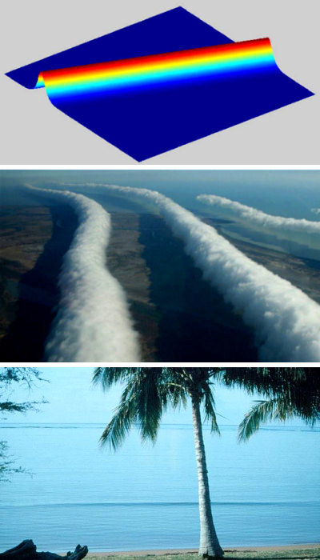
Part 3: Basic notions on solitary waves
Solitons
Definition: A soliton is a solitary wave, solution of wave equation which asymptotically preserves the same shape and velocity after a collision with other solitary waves.
Properties:
describe waves on permanent form;
are localized, so that decay or approximate a constant to infinity;
can interact strongly with other solitons, but emerge from the collisions unchanged unless a motion phase.

Slide 23
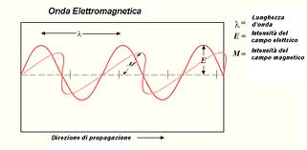
3.1 Linear and non linear wave equations
Linear wave equations
D’Alembert wave equation for 1-D linearly elastic systems:
The DA equation admits the following harmonic solution:

Slide 24
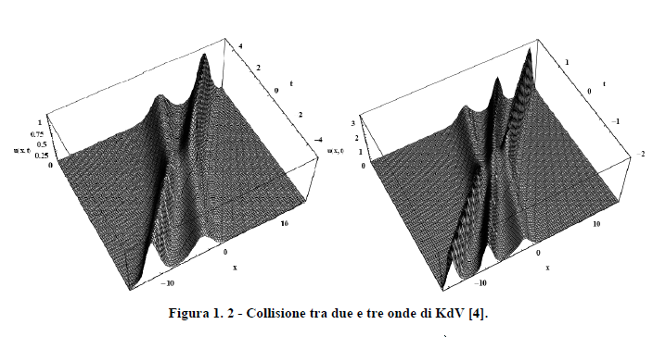
Non-linear wave equations
Korteweg – de Vries equation (KdV) for propagation of solitary waves in water :
Nesterenko equation for solitary waves in granular materials:

Slide 25
Newton’s cradle
http://www.youtube.com/watch?v=5d2JAVgyywk
..\YouTube - Newtons's Cradle for iPhone.htm

Slide 26
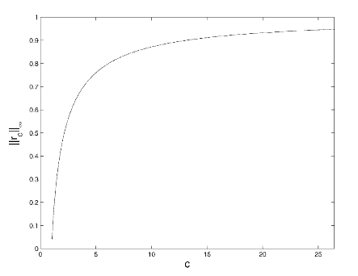
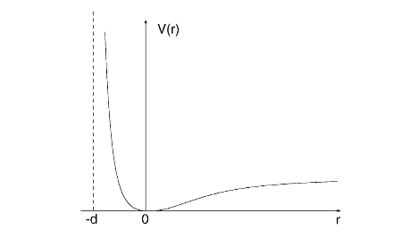
Non linear behaviour corresponding to Lennard-Jones potential at the microscopic scale
Fig 1
Fig 3
Fig 2
Fig 1: Lennard-Jones type potential describing e.g
Van der Waals forces
Fig 2 : Displacement wave profile in atomic lattice
systems interacting to Lennard-Jones type
potential
Fig 3 : Wave amplitude vs speed propagation plot

Slide 27
Typical F vs plots in tensegrity prisms
Low cable prestrain
High cable prestrain
lockingeffect

Slide 28
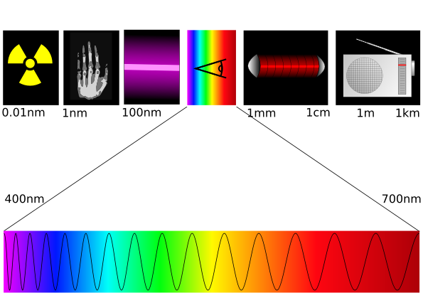
Part 4 : Wave Analysis

Slide 29
4.1: Solitary waves traveling on 1D chains of on Nylon (cables)- Carbon fiber (bars)- Polycarbonate sheets (lumped masses) prisms (NCFPC systems)

Slide 30
System layout
Bars
PultrudedCarbonTubing
E=230 GPa
O.D. 4 mm
I.D. 0.100”
Wt./gm = 2 gm
Cross-Cables and Edge Members
Nylon 6
Ø =2 mm
E=1800 MPa
Polycarbonate round sheets
Thick=1.57 mm
Ø= 14 cm
300
prisms

Slide 31
Properties of the generic prism
a= 0.07 m
λ₀= 0.124201 m
L= 0.18 m
ϕ₀=150°
h₀=0.118798 m
λ_{N}=0.121765 m
m= 35 g
m_{striker}= 28 g
k=4.6417 * 10^4 N/m
k0=5.4512 * 10 ^4 N/m
T0= 0.1577 s
h0
L

Slide 32
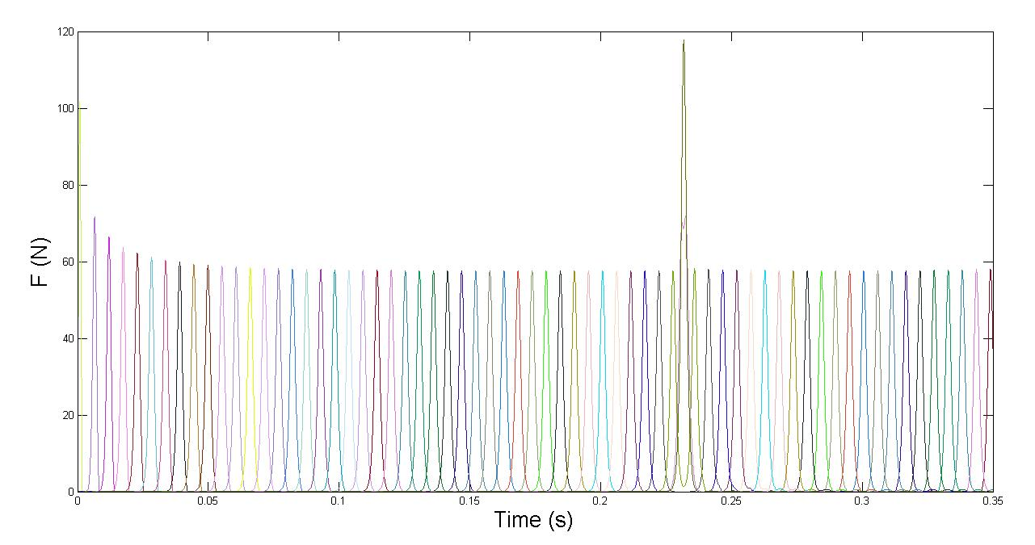
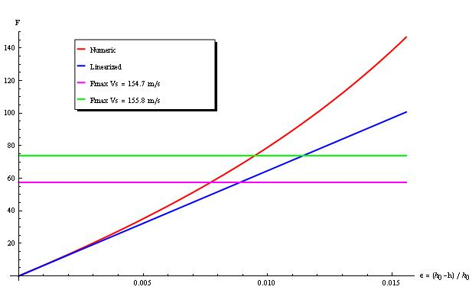
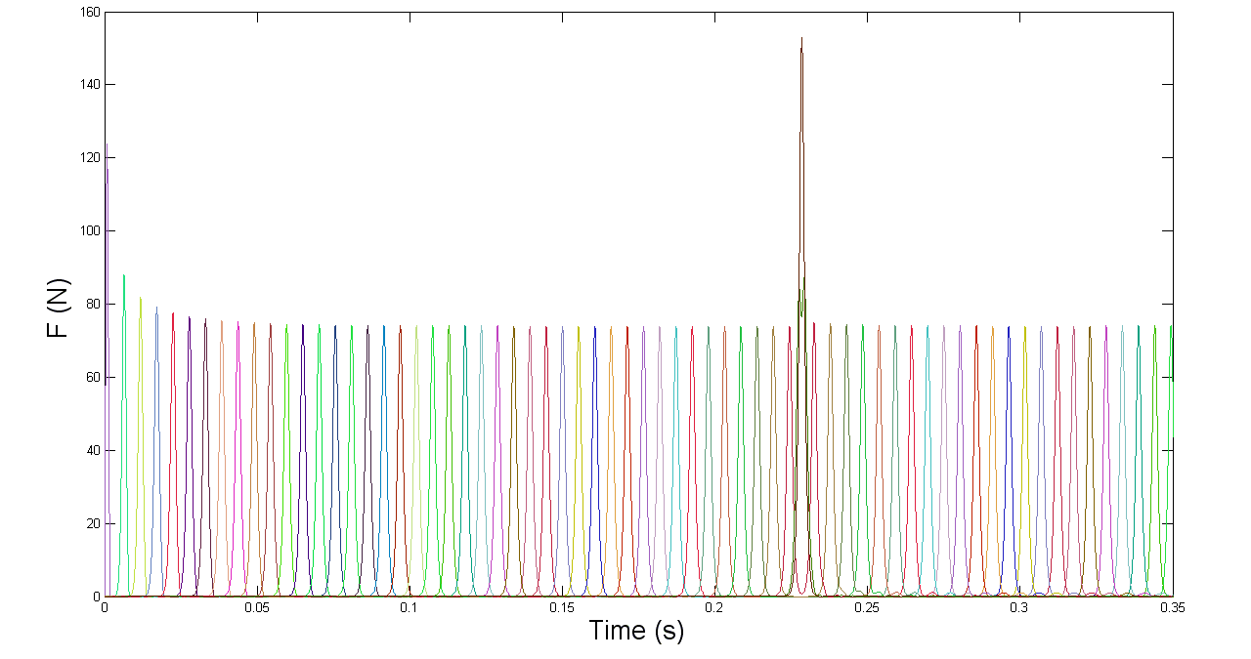
4.1.1 F vs time profiles
wave speed Vs = 154.7 / 155.8 m/s
154.7 m/s
Force-strain response
of the generic prism
Fmax for Vs=155.8 m/s
155.8 m/s
Fmax for Vs=154.7 m/s

Slide 33
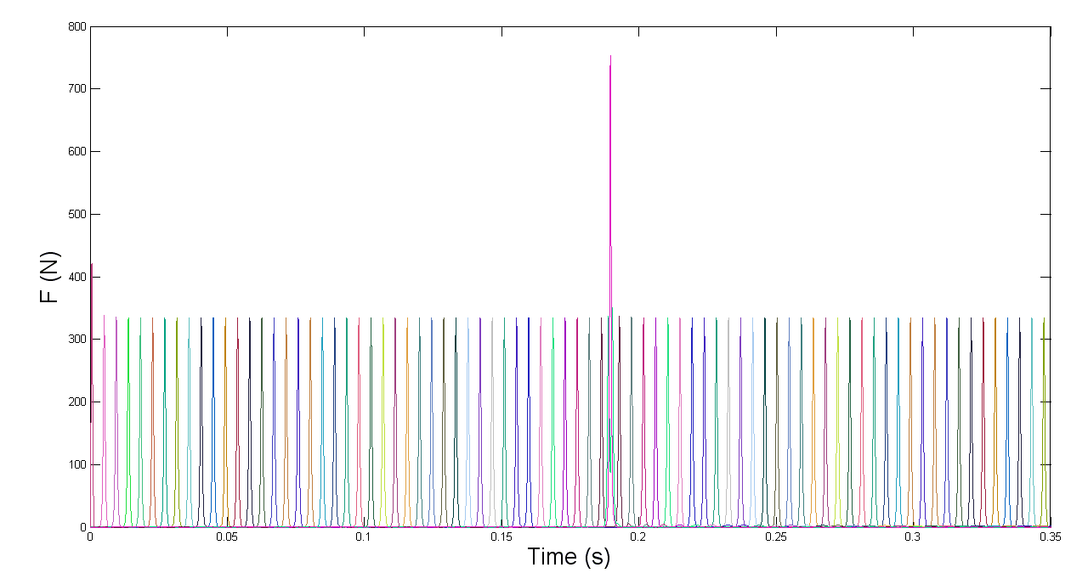
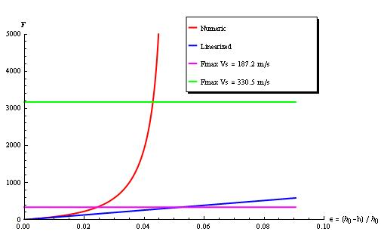
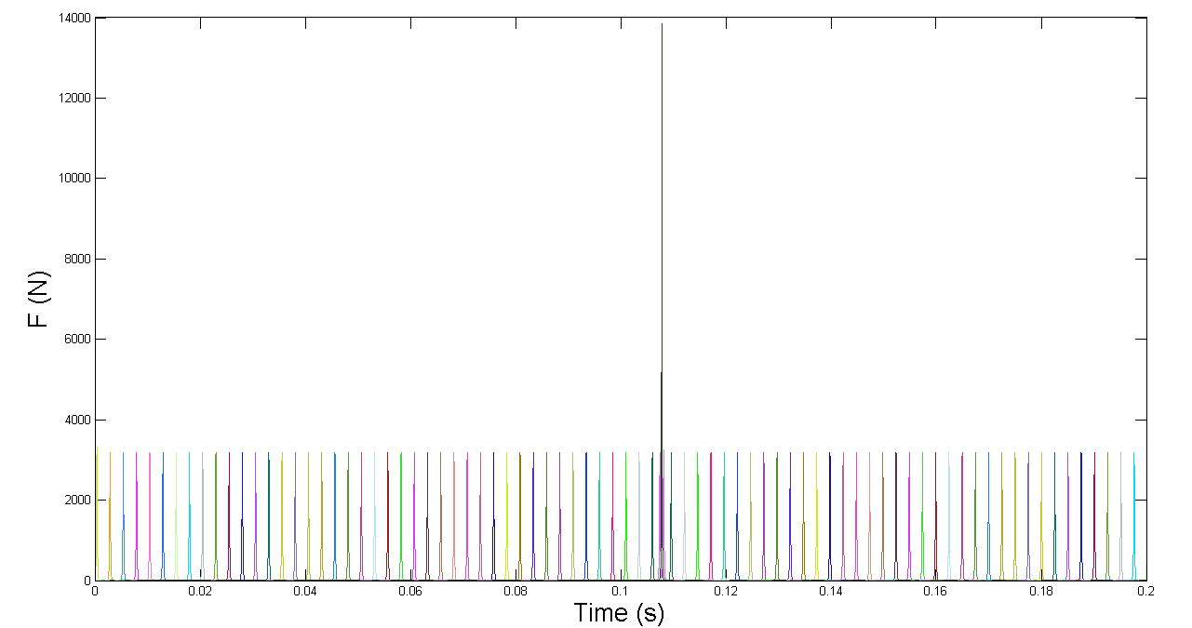
4.1.2 F vs time profiles
wave speed Vs = 187.2 / 330.4 m/s
187.2 m/s
Force-strain response
of the generic prism
Fmax for Vs=330.4 m/s
330.4 m/s
Fmax for Vs=187.2 m/s

Slide 34
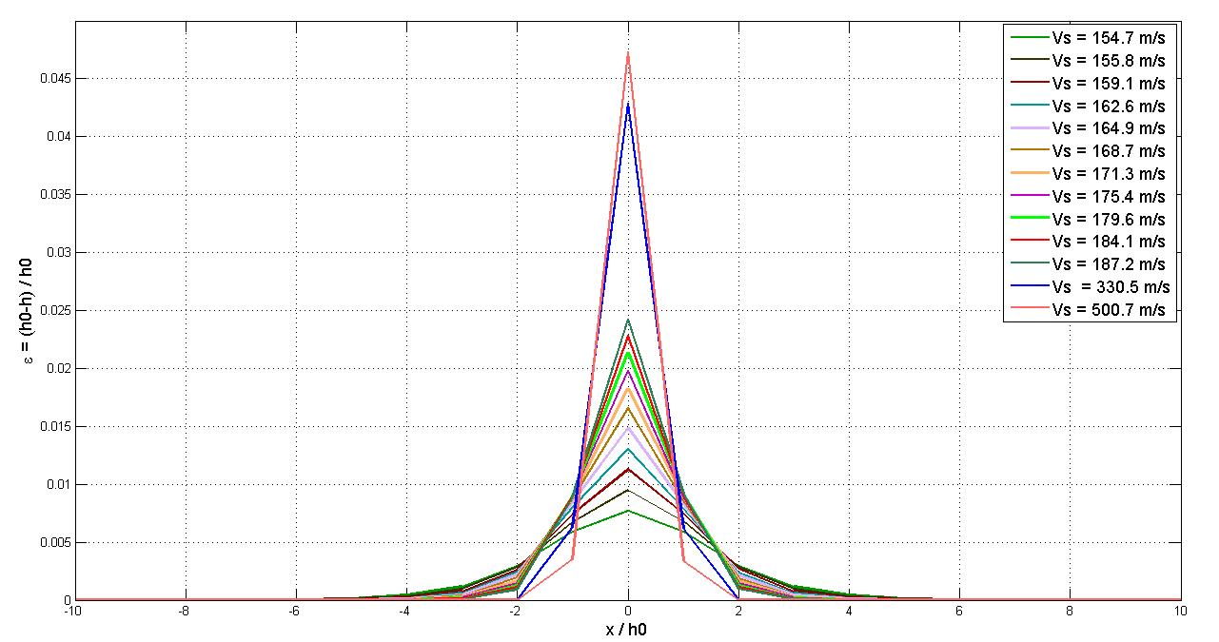
4.1.3 Profile of strain waves
for different wave speeds Vs

Slide 35
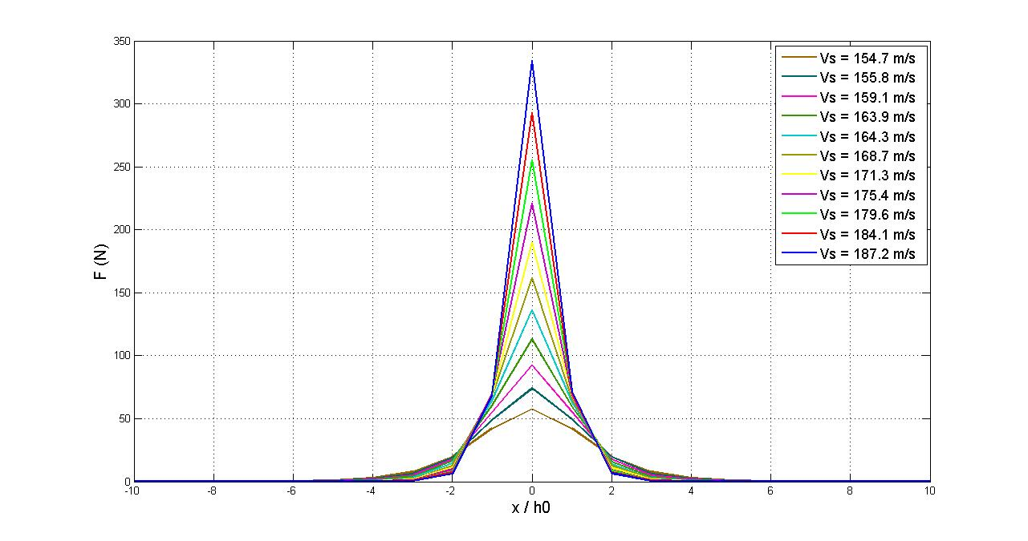
4.1.4 Profile of force waves
Wave speed Vs in between 154.7 m/s and 187.2 m/s

Slide 36
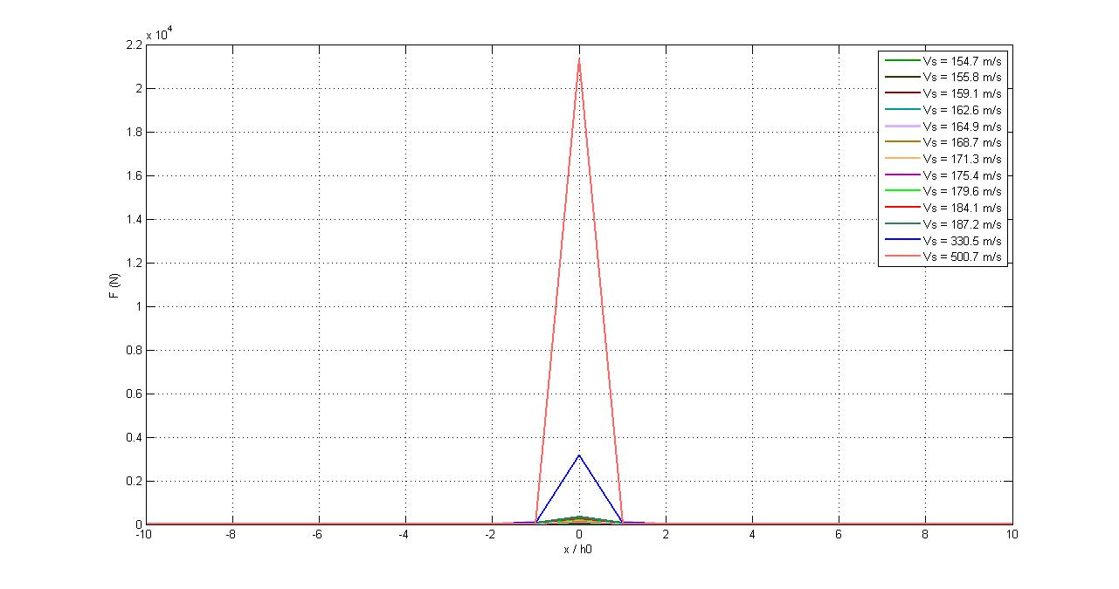
4.1.5 Profile of force waves
Wave speed Vs in between 154.7 m/s and 500.7 m/s

Slide 37
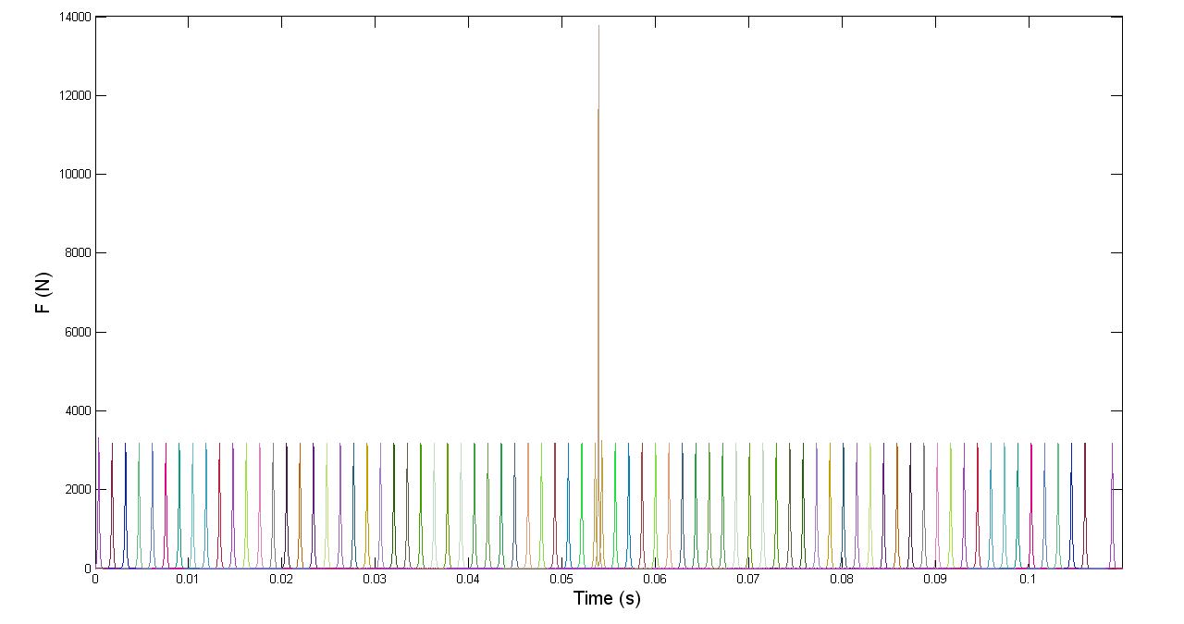
4.1.7 Force vs time plot
Collision of two solitary waves traveling with Vs = 330.5 m/s

Slide 38
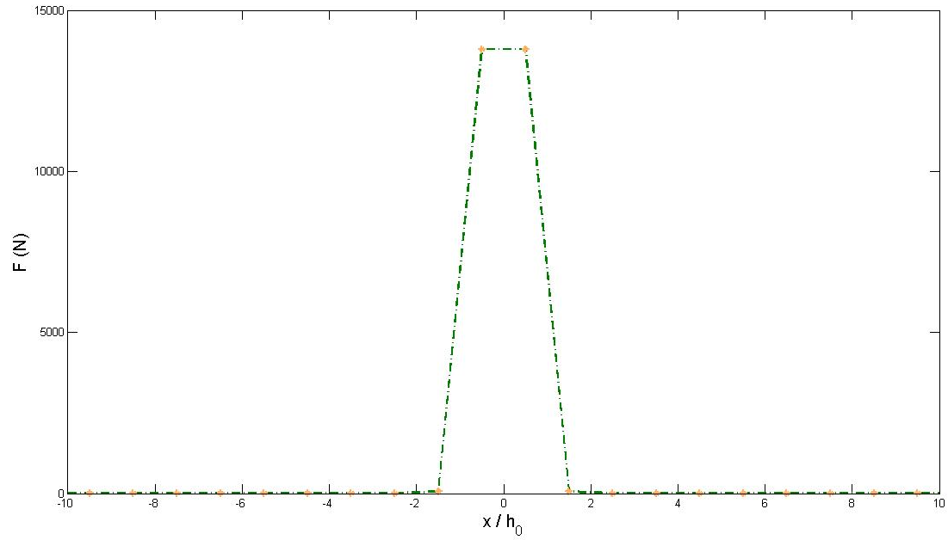
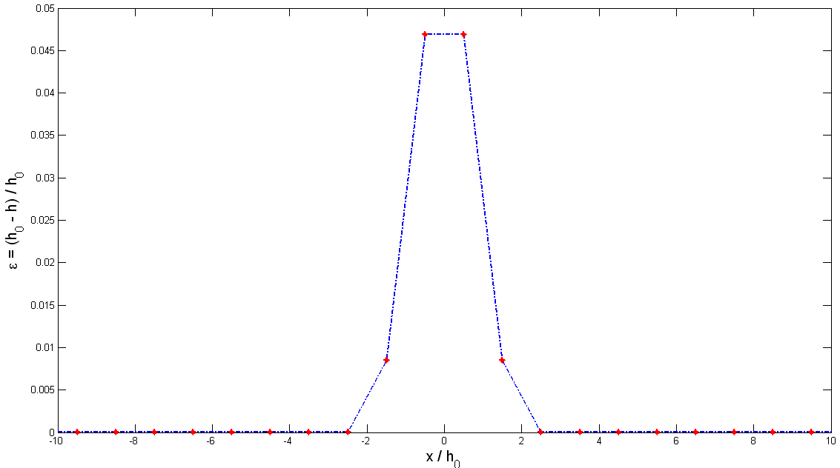
4.1.8 Profiles of force and strain waves
Collision of two solitary waves Vs = 330.5 m/s

Slide 39
4.1.9 Force vs time animation
Collision of two solitary waves with Vs = 330.5 m/s

Slide 40
4.2: Solitary waves traveling on 1D chains of on PMMA (cables)- Carbon fiber (bars)-Polycarbonate sheets (lumped masses) prisms (PMMACFPC systems)

Slide 41
System layout
Bars
PultrudedCarbonTubing
E=230 GPa
O.D. 4 mm
I.D. 0.100”
Wt./gm = 2 gm
Cross-Cables and Edge Members
Eska™ PMMA Optical Fiber
Model CK-80
D=2mm
E=2.5GPa
Polycarbonate round sheets
Thick=1.57 mm
Ø= 14 cm
300
prisms

Slide 42
Properties of the generic prism
a= 0.07 m
λ₀= 0.124201 m
L= 0.18 m
ϕ₀=150°
h₀=0.118798 m
λ_{N}=0.121765 m
m= 35 g
m_{striker}= 28 g
k=6.5 * 10^4 N/m
k0=7.56 * 10 ^4 N/m
T0= 4.3 * 10^ -3 s
h0
L

Slide 43
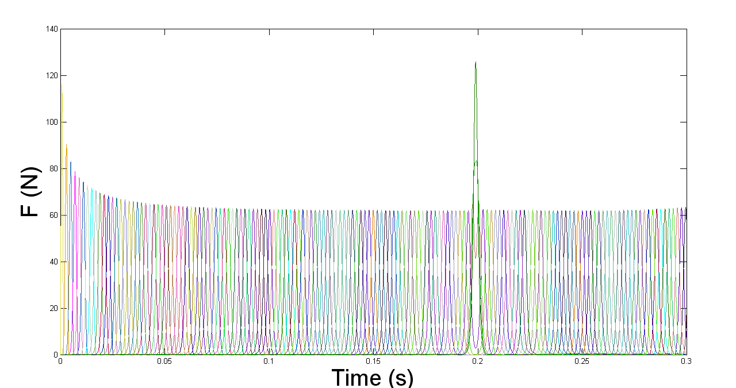
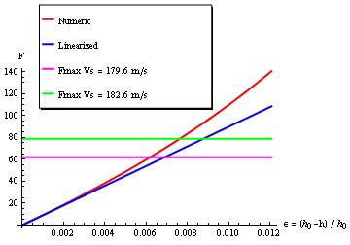
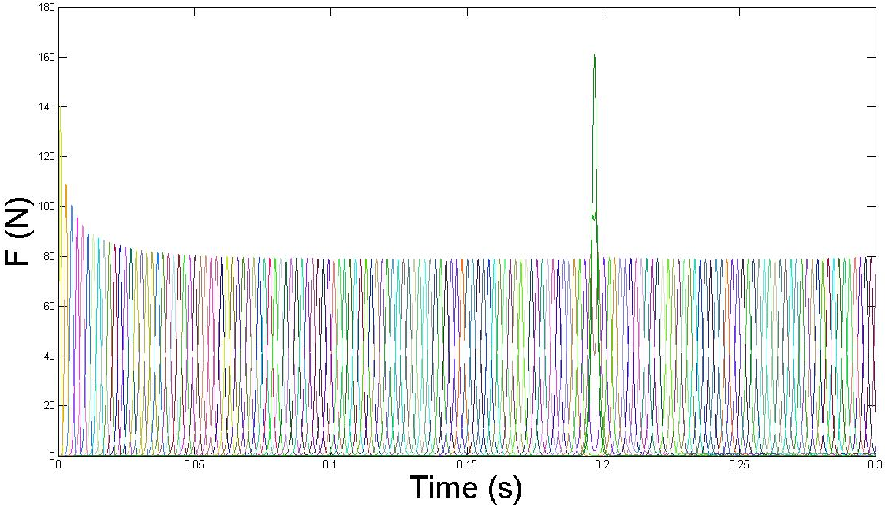
4.2.1 F vs time profiles
Wave speed Vs = 179.6 / 182.6 m/s
179.6 m/s
Force-strain response
of the generic prism
Fmax for Vs=182.6 m/s
182.6 m/s
Fmax for Vs=179.6 m/s

Slide 44
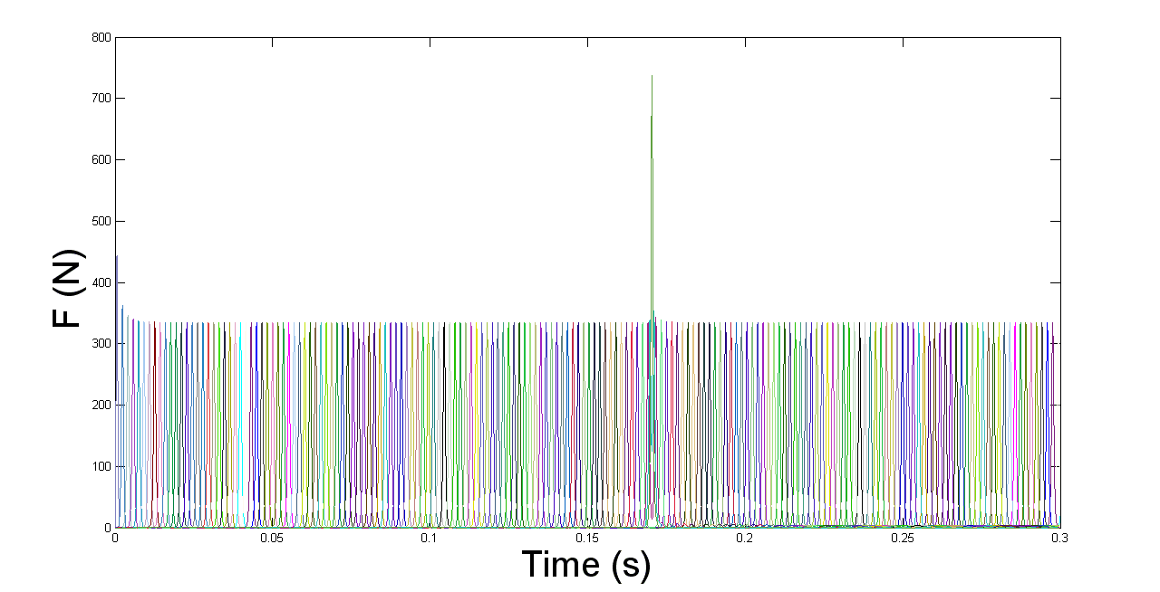
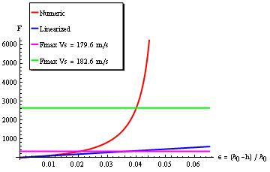
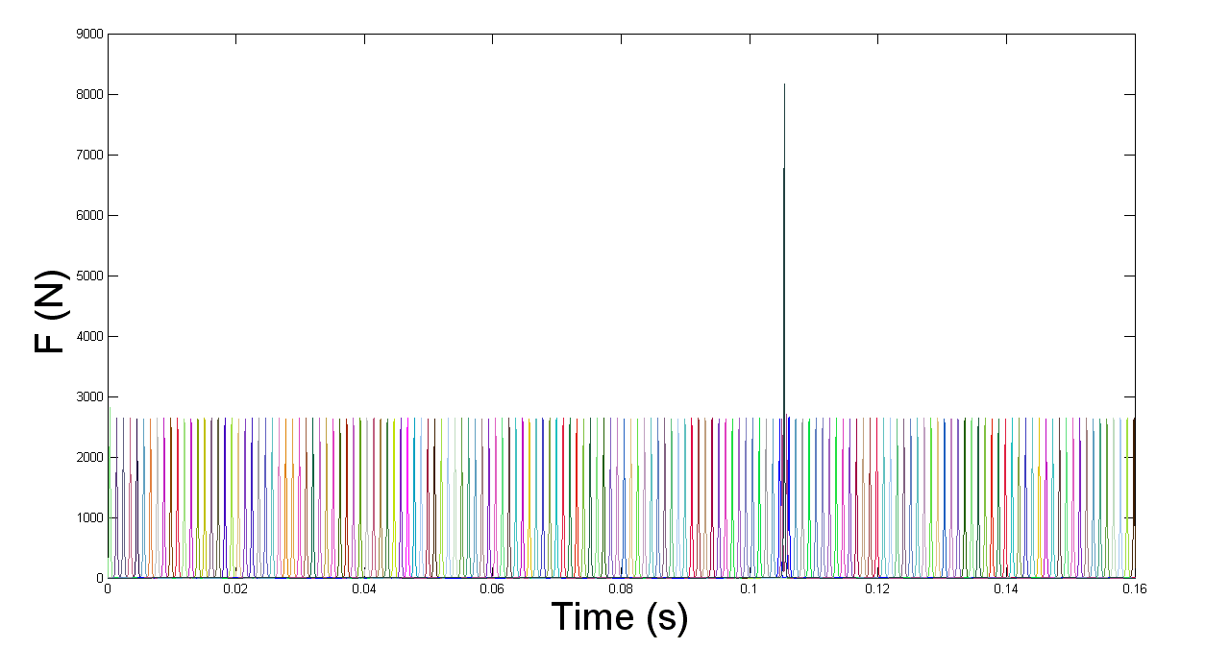
4.2.2 F vs time profiles
Wave speed Vs = 210.1 / 337.5 m/s
210.1 m/s
Force-strain response
of the generic prism
Fmax for Vs=337.5 m/s
337.5 m/s
Fmax for Vs=210.1 m/s

Slide 45
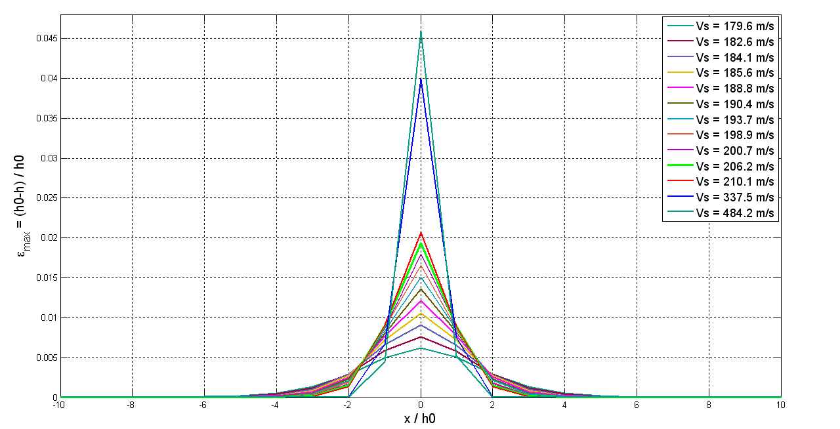
4.2.3 Profile of strain waves
for different wave speeds Vs

Slide 46
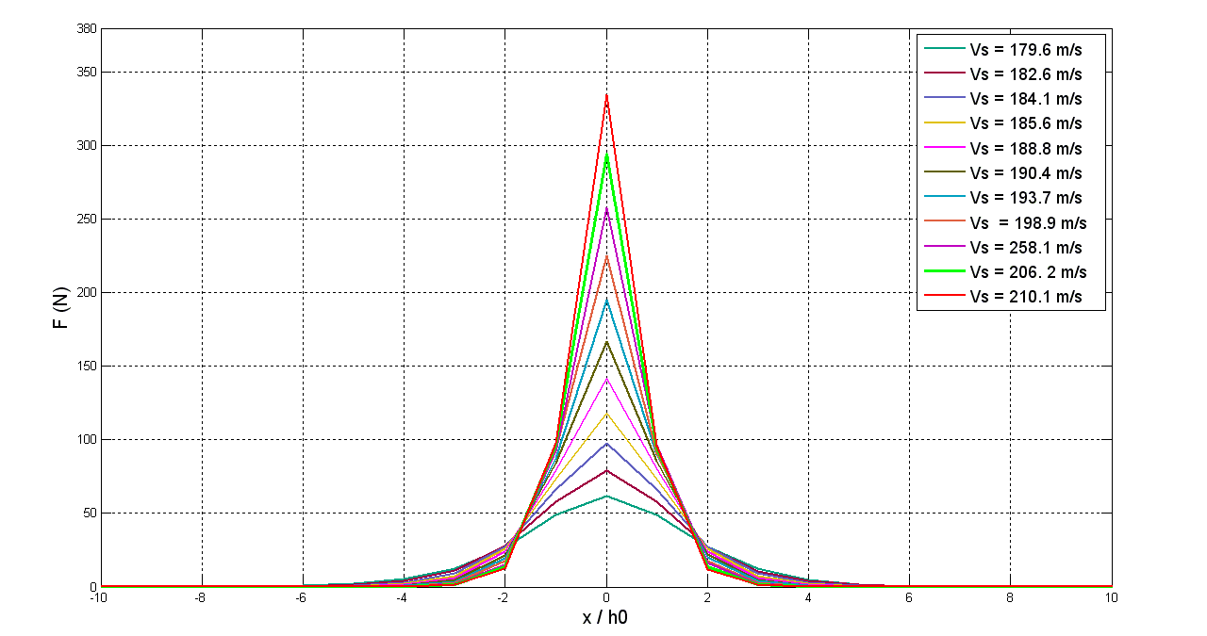
4.2.4 Profile of force waves
Wave speed Vs in between 179.6 m/s and 210.1 m/s

Slide 47
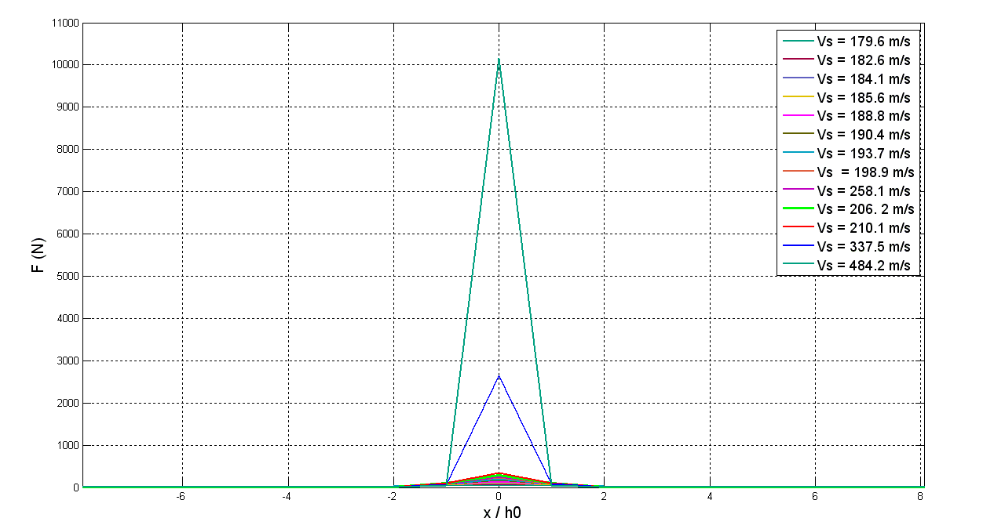
4.2.5 Profile of force waves
Wave speed Vs in between 179.6 m/s and 484.2 m/s

Slide 48
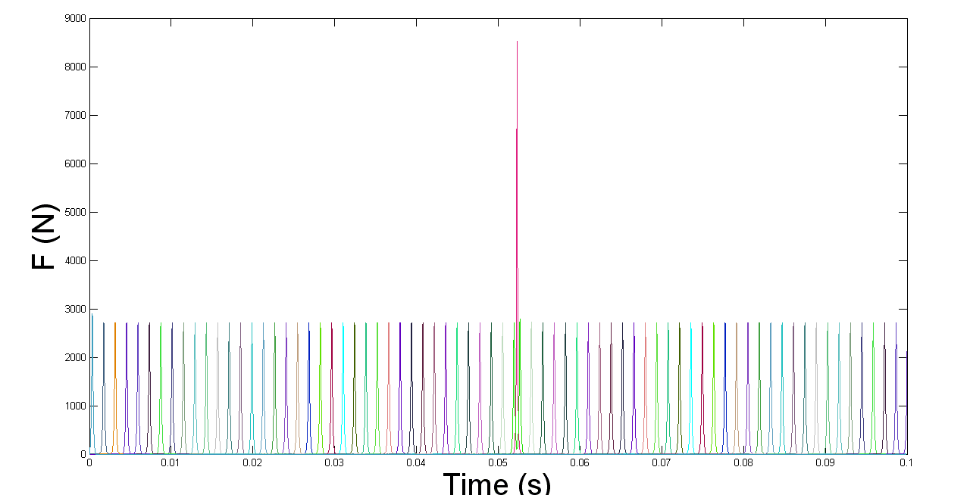
4.2.7 Force vs time plot
Collision of two solitary wavestraveling with Vs=337.5 m/s

Slide 49
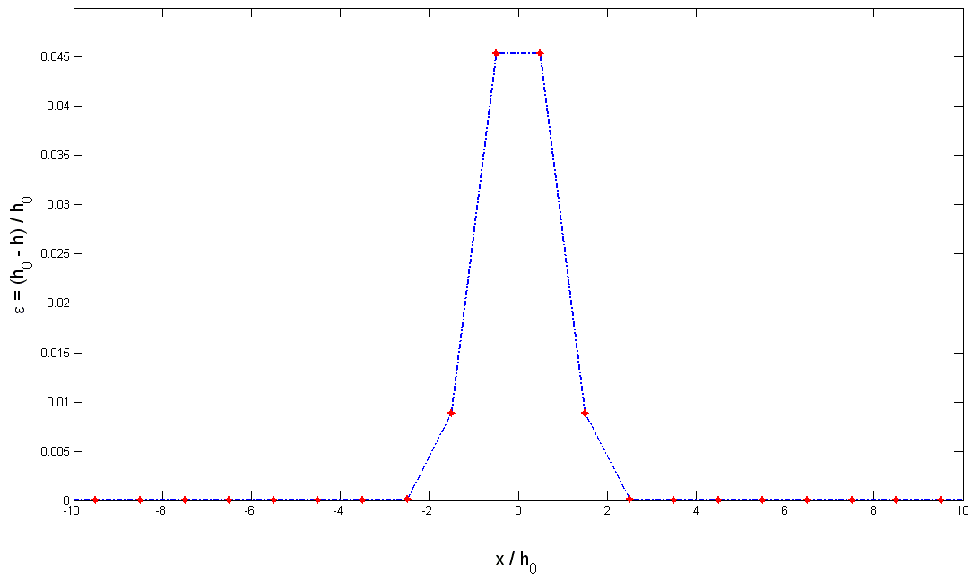
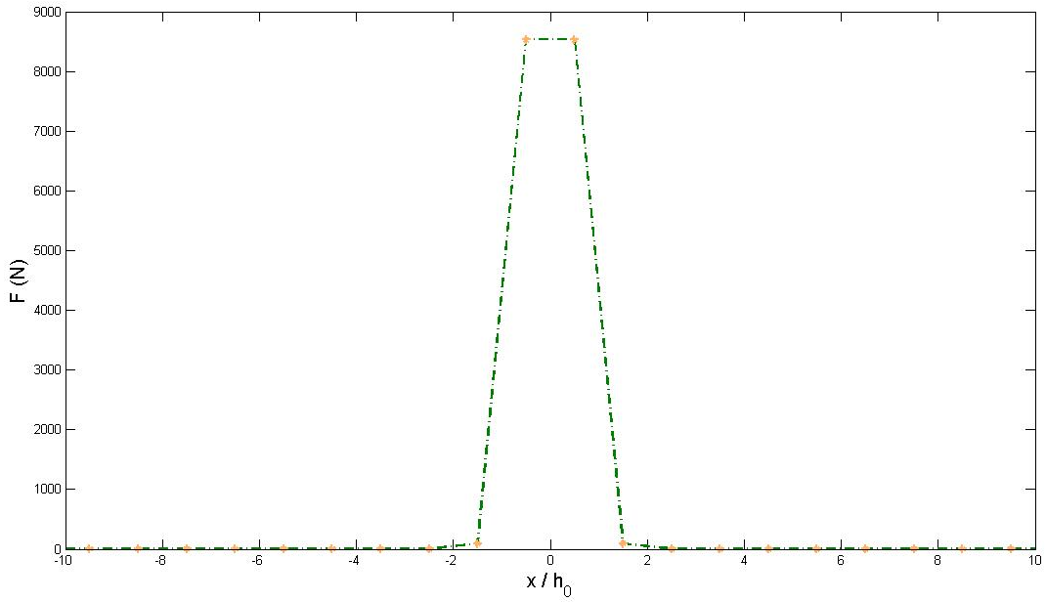
4.2.8 Profiles of force and strain waves
Collision of two solitary waves with Vs = 337.5 m/s

Slide 50
4.2.9 Force vs time animation
Collision of two solitary waves traveling with Vs = 337.5 m/s

Slide 51
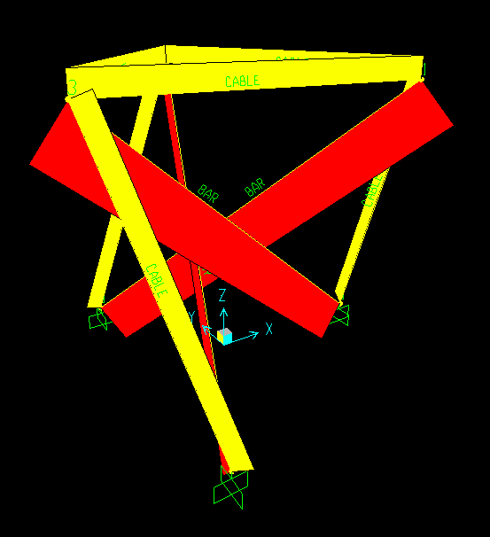
Part 5: STRENGTH ANALYSIS
3D axial force distribution in a tesegrity prism subject to a vertical compressive force
yellow: tensile member forces
red: compressive member forces

Slide 52
5.1 NCFPC system
Threshold force values
Values from simulations
F_{max}⁽⁴⁾= 184.8 N
P_{cable_max}=119 N
P_{bar_max}= 213 N
Safety factors
P_{lim}/P_{cable_max}= 1.85
P_{buckling}/P_{bar_max} =3.5
F _{locking} ⁽¹⁾ = 1.6 KN
F_{lim}⁽²⁾ = 219.9 N
P_{buckling} ⁽³⁾ = 737.3 N
(1) F_{locking} = axial force producing locking of the prism
(2) F_{lim} = limit force of cross cables
(3) P_{buckling}= buckling force of bars
(4)F_{lmax}= F_{max,steady_state}x2

Slide 53
5.2 PMMACFPC system
Threshold force values
Values from simulations
F_{max}⁽⁴⁾= 195.2 N
P_{cable_max}=133.5 N
P_{bar_max}= 287.8 N
Safety factors
P_{lim}/P_{cable_max}= 1.68
P_{buckling}/P_{bar_max} =2.56
F _{locking} ⁽¹⁾ = 2.3 KN
F_{lim}⁽²⁾ = 224 N
P_{buckling} ⁽³⁾ = 737.3 N
(1) F_{locking} = axial force producing locking of the prism
(2) F_{lim} = limit force of cross cables
(3) P_{buckling}= buckling force of bars
(4)F_{lmax}= F_{max,steady_state}x2

Slide 54
Part 6 : Concluding remarks
The numerical analysis carried out in the present study highlights that 1-D prisms support solitary waves with special features, as the wave speed Vs increases. Such features include:
Convergence of the Force vs strain response to a “locking” behavior (perfectly rigid response);
Monotonic growth of the maximum force supported by the system;
Asymptotic convergence of the maximum axial strain experienced by the system to a finite value;
Convergence of the wave width to a limit value that is approximately equal to 4h₀.

Slide 55
The above results suggest the possible use of arrays of tensegrity prisms as novel metamaterials, which could be employed to perform a variety of special applications, such as, e.g., energy trapping, acoustic band gap filters, acoustic lenses , negative Poisson ratio (“auxetic”) materials, etc.
The study of such applications, and the experimental and mathematical validation of the numerical analysis carried out in the present study are addressed to future work.

Slide 56
References
Skelton R., ’Dynamics of Tensegrity Systems: Compact Forms’, 45th IEEE Conference on Decision and Control, pp. 2276-2281, 2006.
Skelton R., ’Matrix Forms for Rigid Rod Dynamics of Class 1 Tensegrity Systems’
Tibert A.G., ’Deployable tensegrity structures for space applications’, PhD Thesis, Royal institute of technology, Sweden, 2003.

Slide 57
References
Skelton, R.E. and M.C. de Oliveira, ’Tensegrity Systems’, Springer-Verlag, 2009.
Han, J., Williamson, D., Skelton, R.E., EquilibriumConditionsof a TensegrityStructures, Int. J. SolidsStruct., 40, 2003, 6347-6367.
Skelton, R.E., Helton, J.W., Adhikari, R., Pinaud, J.P., Chan, W., An Introduction to the Mechanics of Tensegrity Structures. The Mechanical Systems Design Handbook: Modeling, Measurement, and Control, CRC Press, 2001.

Slide 58
References
Skelton, R.E., Helton, J.W., Adhikari, R., Pinaud, J.P., Chan, W., Dynamics of the shellclassoftensegritystructures.The MechanicalSystems Design Handbook: Modeling, Measurement, and Control, CRC Press, 2001.
Skelton, R.E., Williamson D., Han, J., Equilibrium Conditions of a Class I Tensegrity Structure (AAS 02-177), pp 927 – 950, Volume 112 Part II, Advances in the Astronautical Sciences, Spaceflight Mechanics 2002.
Oppenheim, O. J., Williams, W. O., Geometriceffects in anelastictensegritystructure, J. Elasticity, 59, pp 51-65, 2000

